Slide 1
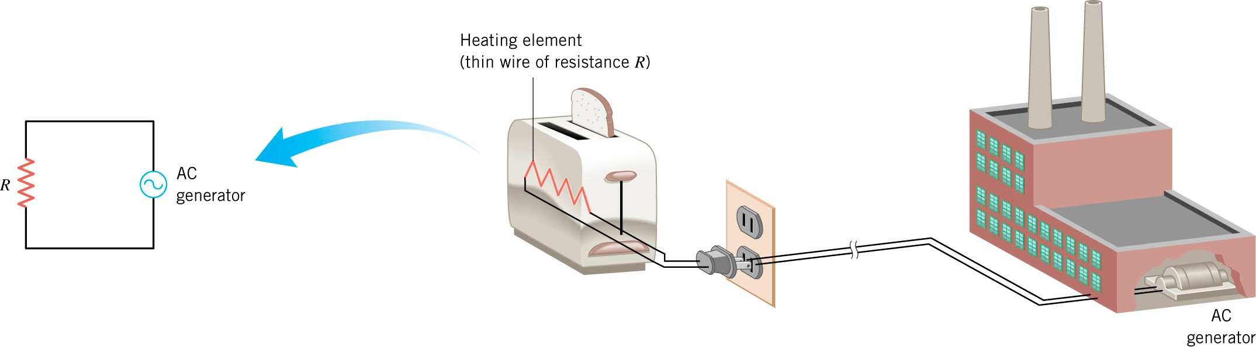

University Physics
Chapter 15 ALTERNATING-CURRENT CIRCUITS

Slide 2
Learning Objectives
15.1 AC Sources
Introduction
15.2 Simple AC Circuits
Resistors, Capacitors, Inductors
15.3 AC RLC Series Circuits
Phasor Diagrams
15.4 Power in AC Circuits
RMS Power
15.5 Resonance
Q-Factor
15.6 Transformers

Slide 3
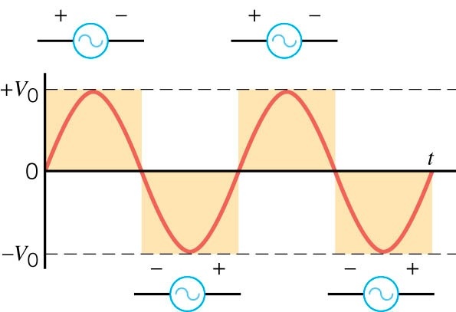
Figure 15.3
15.1 AC SOURCES
Remember from Ch. 13 on Faraday’s Law we found that we can generate emf’s or voltages using rotating coils.
This is the basis of power generation for the transmission of electricity.
Devices that generate the power are typically sinusoidal, time-varying sources.
We call these Alternating Current (AC) sources.
Here in the USA typical electrical outlets provide a potential difference of 120 V at a frequency of 60 Hz.
  In other parts of the world: 220/240 V at 50Hz
Thus, the source voltage (or current) can be characterized by:
Where, V₀ is the peak voltage.
15.1
Flow of charge reverses direction periodically… and therefore, so does the voltage...

Slide 4
resistors
15.2 SIMPLE AC CIRCUITS
When we connect a resistor to an ac voltage source, we can use Ohm’s law to find the current flowing through the resistor:
Because in ac circuits the voltage and current can both be positive and negative, it is convenient to define the root mean square (rms) voltage or current:
The average squared voltage over one cycle:
Which defines the rms voltage:
And a similar equation for current.
15.2
peak current

Slide 5
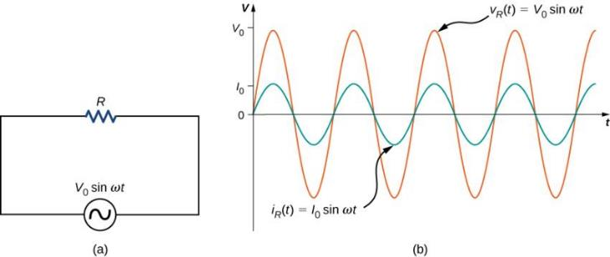
Figure 15.5
For the simple resistive circuit, we find that if the voltage has a sinusoidal dependence, the current has exactly the same time dependence.
In other words they are in phase with each other.
So, whenever the voltage is at its peak value, so to is the current.

Slide 6
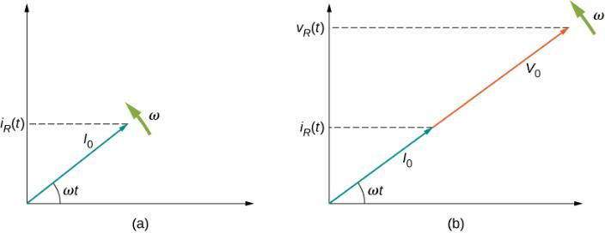
Figure 15.6
phasor diagrams
We can represent the time-dependence of the voltage/current as a rotating vector (by virtue of its sinusoidal nature).
This is known as a phasor diagram.
The phasor diagram representing the current through the resistor.
The phasor diagram representing both i_{R}(t) and v_{R}(t) .

Slide 7
capacitors
We can extend the concept of phasor diagrams to other circuit components.
We will see differences between resistors, capacitors, and inductors.
For capacitors, remember the charge on a capacitor, Q = CV.
Now, for time-dependent voltages:
And current is the time-derivative of charge:
With, I₀ = ω C V₀
Rewrite this as:
We can define an effective resistance associated with the capacitor through Ohm’s law:
capacitive reactance
15.3

Slide 8
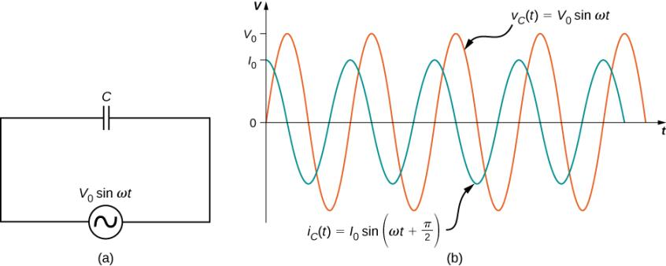
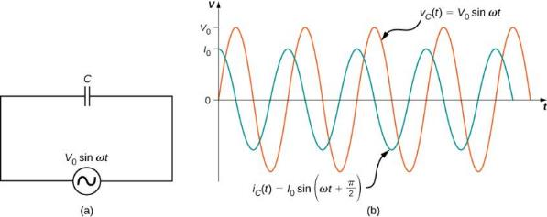
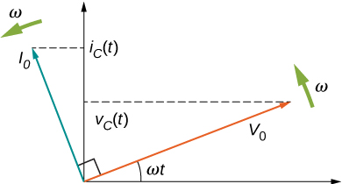
Figure 15.8
capacitor phasor diagram
Figure 15.7
A capacitor connected across an ac generator.
The current i_{C}(t) through the capacitor and the voltage v_{C}(t) across the capacitor. Notice that i_{C}(t) leads v_{C}(t) by 𝜋/2 rad.
The phasor diagram for the capacitor of Figure 15.7. The current phasor leads the voltage phasor by 𝜋/2 rad as they both rotate with the same angular frequency.

Slide 9
inductors
Remember the voltage difference across an inductor:
So the current is obtained by integrating the voltage:
Giving,
With, I₀ = - V₀ / ω L
Hence, Ohm’s Law yields:
15.7
inductive reactance
15.8

Slide 10
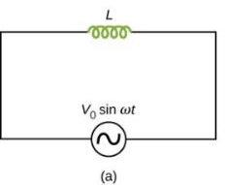
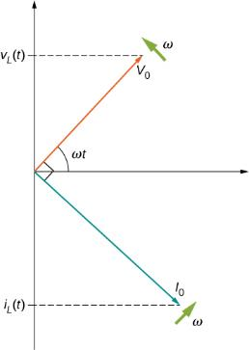
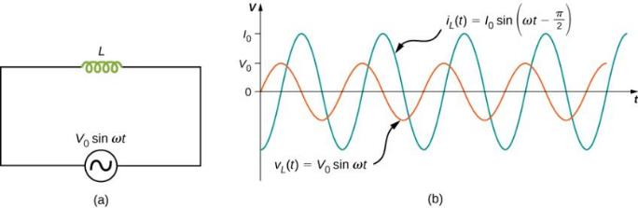
Figure 15.10
inductor phasor diagram
Figure 15.9
An inductor connected across an ac generator.
The current i_{L}(t) through the inductor and the voltage v_{L}(t) across the inductor. Here i_{L}(t) lags v_{L}(t) by 𝜋/2 rad.
The phasor diagram for the inductor of Figure 15.9. The current phasor lags the voltage phasor by 𝜋/2 rad as they both rotate with the same angular frequency.

Slide 11
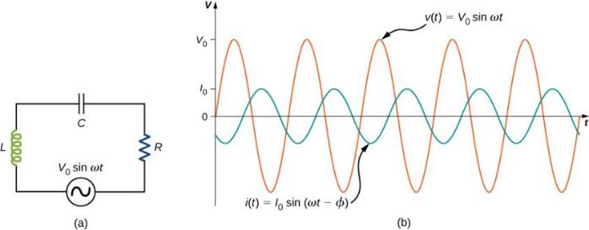
resistors, capacitors, inductors in series
15.3 RLC SERIES CIRCUIT
A circuit that contains a resistor (R), capacitor (C), and an inductor (L) is called a RLC circuit.
Using Kirchoff’s laws to sum the voltages across each element yields a 2nd order, differential equation:
This is the same as a damped, forced, harmonic oscillator.
Figure 15.11
(differentiate)

Slide 12
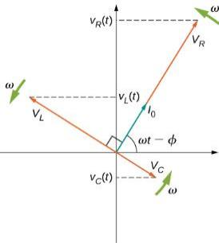
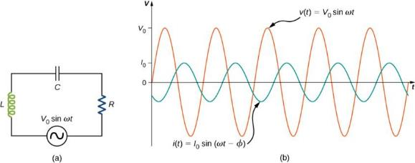
Figure 15.11
RLC Phasor diagram
Phasor diagrams offer an alternative method to analyze RLC circuits without having to solve a differential equation.
The results presented here correspond to the steady state.
Figure 15.12
CIVIL
Circuit Element | Relationship | Reactance X | Phase θ | Angle Notation
Resistor | VR = I R | R | in phase
Capacitor | V_{C} = I X_{C} | X_{C} = 1/ωC | Leads +90º
Inductor | V_{L} = I X_{L} | X_{L} = ωL | Lags -90º

Slide 13
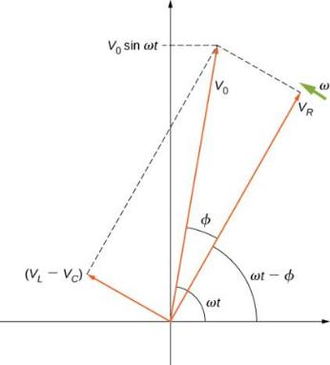
Figure 15.13
impedence
The resultant phasor of amplitude V₀ is obtained as the vector sum of the individual phasor voltages:
Since V_{L} and V_{C} are colinear, we have:
The impedence, Z, is defined through:
And the phase angle between voltage and current:
15.10
The resultant of the phasors for v_{L}(t) , v_{C}(t), and v_{R}(t) is equal to the phasor for v(t) = V₀ sin ωt. The i(t) phasor (not shown) is aligned with the v_{R}(t) phasor.
15.11
15.9

Slide 14
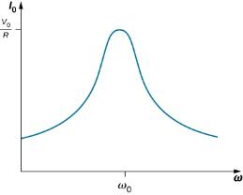
RLC CIRCUIT
15.5 RESONANCE
Notice from the expression for the impedence for the RLC circuit, the current can become very large for certain values of the inductance and capacitance:
In particular, when X_{L} = X_{C}
This defines the resonant frequency ω₀:
RLC circuits were used in devices such as radios to pick out specific radio channels.
Figure 15.18
15.17

Slide 15
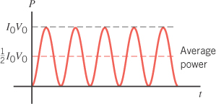
15.4 POWER
For ac circuits, We can find an expression for how the power varies with time using: P = IV
Hence, the time-averaged power:
Which generalizes to:
Where,
15.13
Since the power fluctuates, we consider the average power
15.14

Slide 16
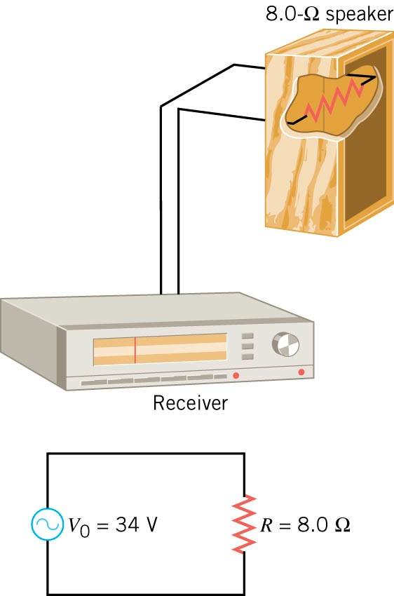
Example: Electrical Power Sent to a Loudspeaker
A stereo receiver applies a peak voltage of 40 V to a speaker. The speaker behaves approximately as if it had a resistance of 10 Ω.
Determine
10-Ω
(a) the rms voltage
(b) the rms current
(c) the average power for this circuit
40 V
10 Ω

Slide 17
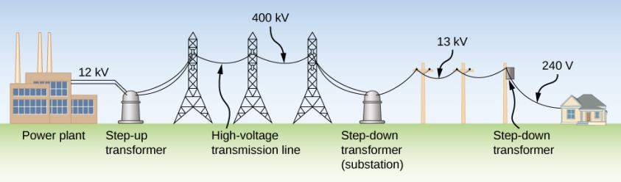
Figure 15.20
15.6 TRANSFORMERS
The rms voltage from a power plant eventually needs to be stepped down from 12 kV to 240 V so that it can be safely introduced into a home. A high-voltage transmission line allows a low current to be transmitted via a substation over long distances.

Slide 18
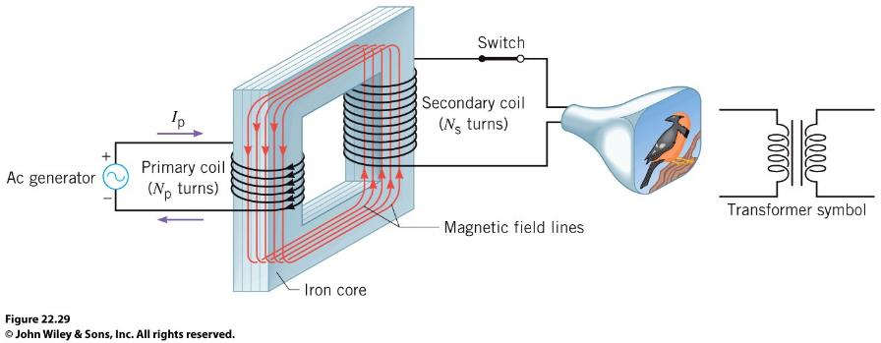
transformers
A transformer is a device for increasing or decreasing an ac voltage.
The ac current in the primary coil creates a changing magnetic field that is fed by the iron core through the primary and secondary coils.
The resulting changing flux generates an induced emf in both the primary (self-inductance) and secondary coils (mutual-inductance).

Slide 19
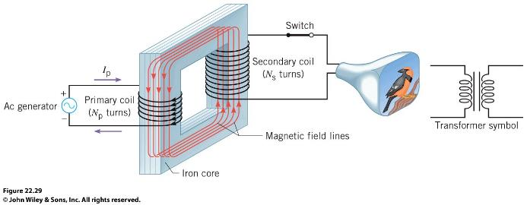
transformer equation
Applying Faraday’s law to both coils:
Now using the fact that the flux is (approximately) the same in both coils:
Finally, if the resistances in the coils are negligible, so the emfs are nearly equal to the terminal voltages, V:
15.20
Transformer equation
15.21
N_{s}> N_{p}: larger secondary voltage ⬄ step-up transformer. Step-down transformer is opposite.

Slide 20
power
The average power delivered to each coil, P =IV, is (approximately) the same (conservation of energy):
Step-up transformer steps up the voltage & steps down the current.
Step-down transformer steps down the voltage & steps up the current.

Slide 21
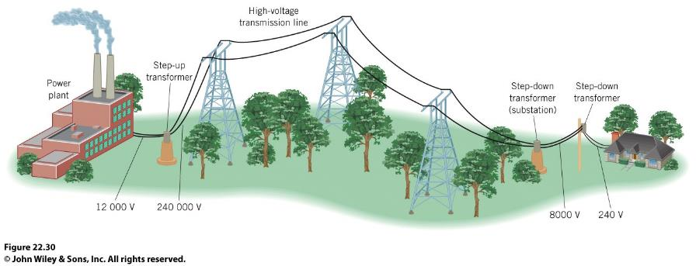
Since, P = I²R, and resistance depends on the cross-sectional area of the wires, electricity is usually transmitted over long distances using thicker wires, higher voltages, and smaller currents in order to reduce the amount of power lost during transmission.

Slide 22
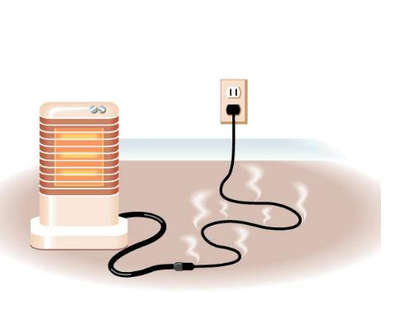
Conceptual Example: Extension Cords and a Potential Fire Hazard
During the winter, many people use portable electric space heaters to keep warm. Sometimes, however, the heater must be located far from a 120-V wall receptacle, so an extension cord must be used. However, manufacturers often warn against using an extension cord. If one must be used, they recommend a certain wire gauge, or smaller. Why the warning, and why are smaller-gauge wires better then larger-gauge wires? (larger gauge wires have smaller cross-sectional area)

