Slide 1
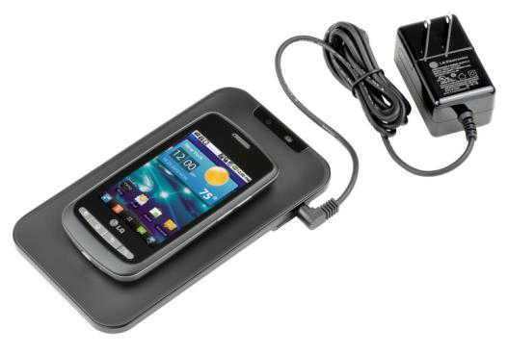

University Physics
Chapter 14 INDUCTANCE

Slide 2
Learning Objectives
14.1 Mutual Inductance
EMFs
14.2 Self-Inductance & Inductors
EMFs
Solenoids
14.3 Energy in Magnetic Field
Energy stored in magnetic field
14.4 RL Circuits
Time-dependence
14.5 LC Circuits
Time-dependence
14.6 RLC Circuits
Damped-harmonic oscillator

Slide 3
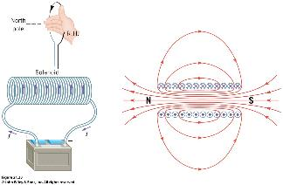
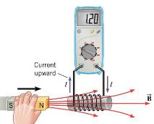
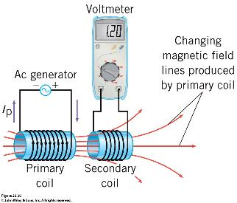
14.1 MUTUAL INDUCTANCE
Remember from Ch. 12 that solenoids are good sources of magnetic fields.
Combine that with the results of Ch. 13 of electromagnetic inductance due to a time-varying magnetic field.
Now imagine we place two solenoids near one another.
The primary coil is connected to a time-varying, ac source.
The changing ac current in the primary coil creates a changing magnetic field and, therefore, a changing magnetic flux through the secondary coil. This generates an induced emf in the secondary coil.
The effect in called mutual induction.

Slide 4
The emf in the secondary coil is given by Faraday’s law:
But, we would like this in terms of the change in current in the first coil.
The net flux through coil 2 = N2Φ21
  Φ21 is the flux through coil 2 due to coil 1
But we also know the magnitude of this net flux is proportional to the current in coil 1: I1.
Thus we have the relationship:
Where, M₂₁ = constant of proportionality called the mutual inductance.
We can reverse the argument to find:
14.1
14.2

Slide 5
MUTUAL INDUTANCE & INDUCED EMF
It turns out that: M₁₂ = M₂₁ = M
M = mutual inductance and is a shape-dependent parameter that depends on the geometry and relative positions of the two coils.
  mathematically difficult to derive in general but can be measured experimentally
SI Unit: M = Henry (H) where 1 H = 1 Vs/A
Typical values of inductance are of order mH or μH.
Finally, plugging back into Faraday’s law:
However, note that this may not be the only emf in coil 2 !
14.3
14.4

Slide 6
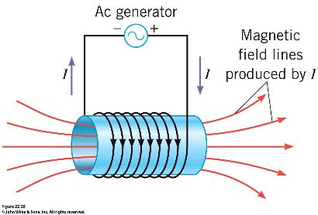
14.2 SELF-INDUCTANCE
We can apply the previous arguments to a coil all by itself.
When a time-varying, or alternating current, passes through the coil, it generates a changing magnetic field in the coil.
This causes the magnetic flux in the coil to change over time.
This generates an induced emf in the coil itself.
The effect is called self induction.

Slide 7
SELF-INDUTANCE & INDUCED EMF
Similarly, we can write: NΦm = L I
L = self-inductance
SI Unit: M = Henry (H) where 1 H = 1 Vs/A
Typical values of inductance are of order mH or μH.
And emf induced in the circuit of the coil carrying a current I:
14.9
14.10

Slide 8
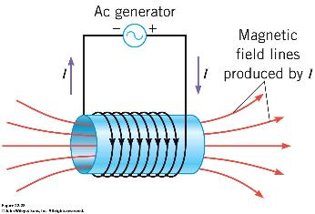
Example: emf Induced in a Long Solenoid
A long solenoid of length 10 cm and x-sectional area 4 x 10⁻⁵ m² contains 8000 turns/m.
What is the emf induced in the solenoid when the current changes from 0 A to 2.0 A over 0.1s?
The emf produced by self-inductance is given by
length of solenoid
-6.4 mV

Slide 9
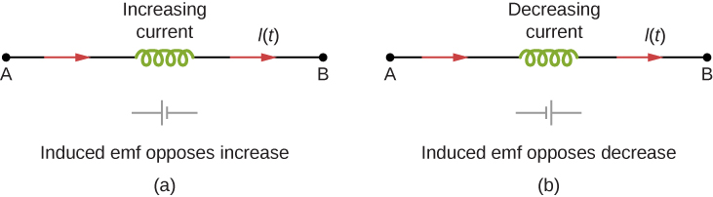
Inductors in circuit
Symbol used to represent an inductor in a circuit.
figure 14.6
figure 14.8
The induced emf across an inductor always acts to oppose the change in the current. This can be visualized as an imaginary battery causing current to flow to oppose the change in (a) and reinforce the change in (b).

Slide 10
cylindrical solenoid
Back in Ch. 12 we found the magnetic field of a solenoid:
Which allows us to calculate the flux:
Which we can now equate with the self-inductance:
14.11
14.12
14.13/4

Slide 11
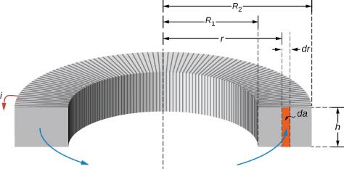
rectangular toroid (Figure 14.10)
Also, in Ch. 12 we found the magnetic field of a toroid:
To calculate the flux we have to take into account that B varies with r:
Leading to:
14.15
14.16
14.17

Slide 12
energy stored in inductor
14.3 ENERGY IN A MAGNETIC FIELD
In a circuit with an inductor work is done by battery to move charges through an inductor against the induced emf.
This energy eventually becomes stored in the magnetic field of inductor.
This arises as follows:
  a changing current I induces a back emf in the inductor
  this back emf causes a potential difference V across ends of inductor
  V is just the magnitude of the induced emf:
  thus instantaneous power associated with this process:
Thus, during some infinitesimal time interval dt:
Hence the total energy stored in the inductor:
14.21
14.20

Slide 13
magnetic energy density
This energy is stored in the magnetic field within the coil(s).
Let’s analyze a simple inductor such as the solenoid:
  self-inductance of solenoid
  magnetic field inside solenoid
Hence,
We define the magnetic energy density u_{m} as the energy per unit volume.
So,
This result is completely general.
14.19
14.18

Slide 14
Energy Density of an Electric Field & magnetic Field
Energy stored in a capacitor:
Energy stored in an inductor:
Energy density in electric field:
Energy density stored in magnetic field:

Slide 15
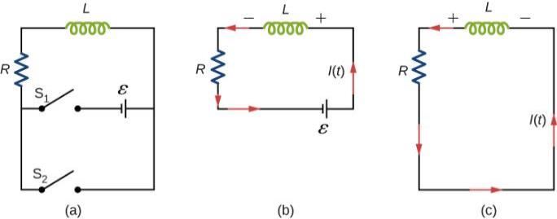
Figure 14.12
14.4 RL CIRCUITS
Circuit containing a resistor (R) & inductor (L).
Inductors suppress rapid changes in current due to self-induced emf.
Useful for stable, steady currents
Here, and next section, we look at the effect of including inductors into circuits
  Resistor could be a separate circuit element or may represent inductor windings.
  Below we assume an ideal circuit.
An RL circuit with switches S₁ and S₂.
Equivalent circuit with S₁ closed and S₂ open.
Equivalent circuit after S₁ is opened and S₂ is closed.

Slide 16
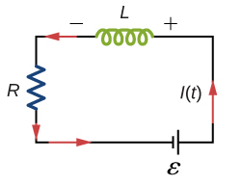
current growth
When switch S₁ is closed (at time t = 0), the source emf produces a current.
As a result, a back emf is induced in the inductor that opposes the original increasing current.
Thus the current cannot change suddenly to its maximum value – there is a growth in the current:
  its value depends on time.
The potential differences across the two elements:
  lower case represent time dependent values.
Apply KVL rule:
This is first-order, ordinary differential equation.
Solution:
14.23
14.24

Slide 17
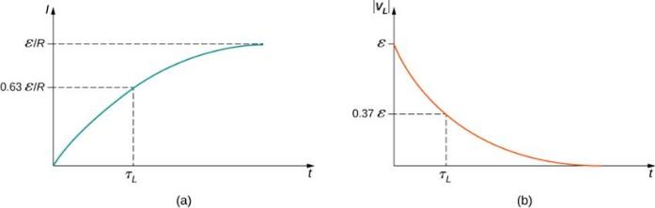
Which we can write as:
Where we have introduced the time constant:
The induced voltage (emf) across the inductor is given by:
14.24
14.25
14.28

Slide 18
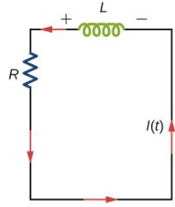
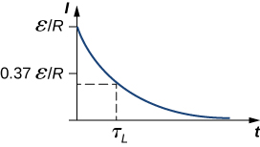
current decay
After ‘enough’ time the current reaches its maximum value:
We then open S1 and close S2 and apply KVL again:
With exponential decay solution:
14.30
14.31

Slide 19
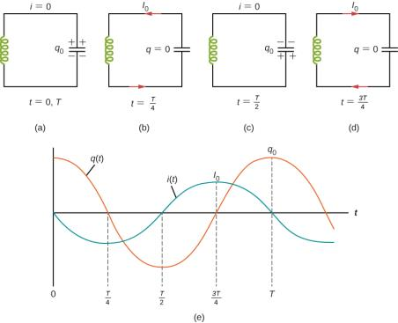
Figure 14.16
14.5 LC CIRCUITS
Circuit containing a capacitor (C) & inductor (L).
No mechanism to dissipate energy.
Result: Oscillating current.
Initial energy supplied by source transfers between capacitor and inductor
  this would occur indefinitely for ideal circuit.
Imagine we have already charged capacitor to initial charge q₀ (Fig. 14.16(a)).
And assume there are no resistances/energy losses in circuit.

Slide 20
Oscillations in an LC Circuit
With the capacitor fully charged:
  The energy U in the circuit is stored in the electric field of the capacitor.
  The energy is equal to q₀² / 2C.
  The current in the circuit is zero.
  No energy is stored in the inductor.
  The switch is closed.
  Charge on capacitor oscillates between maximum positive and negative values.

Slide 21
The current is equal to the rate at which the charge changes on the capacitor.
  As the capacitor discharges, the energy stored in its electric field decreases.
  Since there is now a growing current, some energy is transferred to the inductor.
  Energy is transferred from the electric field to the magnetic field.
Eventually, the capacitor becomes fully discharged.
  Capacitor stores no energy because it has lost all its charge.
  All of the energy is stored in the magnetic field of the inductor.
  The current reaches its maximum value.
After reaching its maximum value, the current then starts to decreases in magnitude, recharging the capacitor with opposite polarity.
  All the energy from the inductor is transferred back to the capacitor.
  The current approaches zero.
  The charge on the capacitor reaches a maximum again but with reverse polarity.
  The process repeats anew.

Slide 22
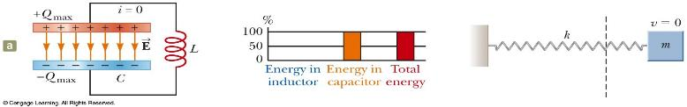
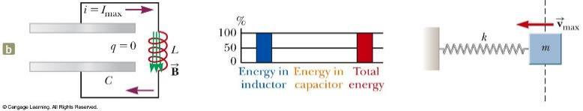
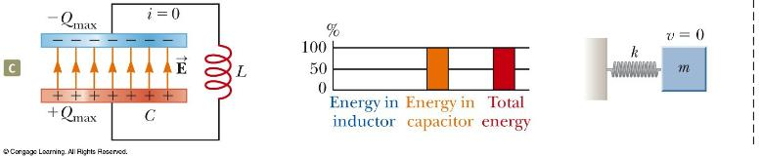
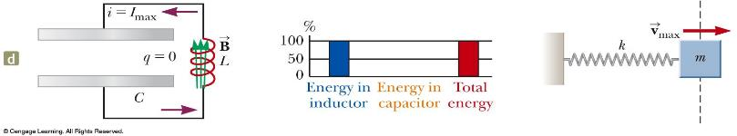
LC Circuit Analogy to Spring-Mass System

Slide 23
applying kVL
For the LC Circuit:
In terms of charge:
Which is analogous to the simple harmonic oscillator.
Hence the solution to this eigenvalue problem:
With,
And the current is given by,
14.40
set by initial conditions
14.41
14.42

Slide 24
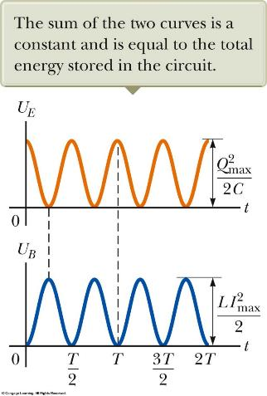
Energy in an LC Circuit
The total energy stored in the LC circuit remains constant in time:
The energy continually oscillates between the energy stored in the electric and magnetic fields.
When the total energy is stored in one field, the energy stored in the other field is zero:
The analogy with mass-spring system becomes more apparent:
14.36
14.35
14.38

Slide 25
14.6 RLC CIRCUITS
A circuit containing a resistor (R), inductor (L), capacitor (C).
Presence of resistor causes losses (see RL circuit earlier).
  a more realistic picture of a real circuit.
What we end up with is a combination of everything we’ve seen up to now:
  capacitor charges and discharges
  electromagnetic energy is transferred between capacitor and inductor
  resistor eventually dissipates this energy
With resistor the problem now resembles that of a damped harmonic oscillator:
  resistance plays role of damping factor or friction, for example in a mechanical system.
Here we focus on the special case of weak damping or ‘small’ resistance.

Slide 26
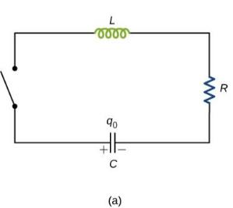
analysis of RLC circuit (Figure 14.17)
Starting of with similar situation as previously: capacitor is initially charged to some value q₀.
Applying KVL:
We get the following differential equation in q(t):
Generally, there are three distinct solutions:
  underdamped ( R² < 4L/C )
  critically damped ( R² = 4L/C )
  overdamped ( R² > 4L/C )
14.44

Slide 27
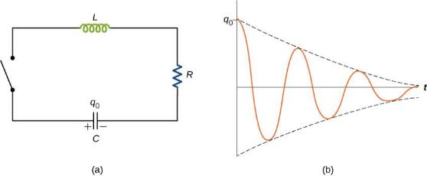
Underdamped RLC circuit
Here we focus on the underdamped circuit: R² < 4L/C
The solution to the linear, second-order differential equation:
Where,
14.45
14.46
Original oscillatory behavior of LC circuit survives.
But bounded by exponential decay envelope.
Eventually, energy in circuit is dissipated through the resistor.
If you include a source emf -> forced, damped, harmonic oscillator (see next chapter).

Slide 28
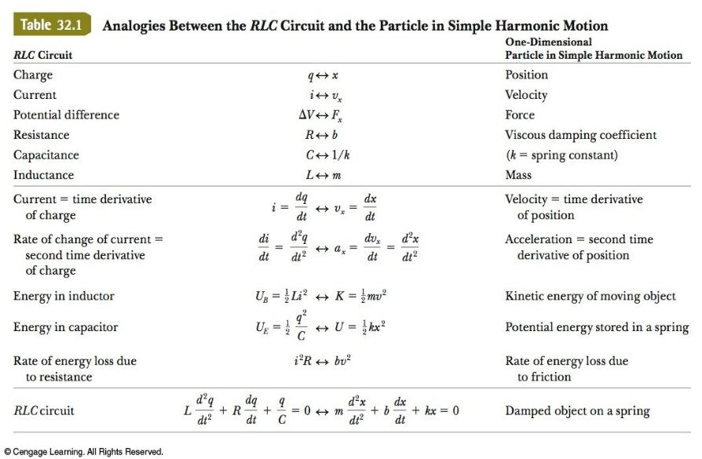
Summary: Analogies Between Electrical and Mechanic Systems

